Slide 2
Topics
The if Statement
The if-else Statement
Comparing Strings
Nested Decision Structures and the if-elif-else Statement
Logical Operators
Boolean Variables
Conditional Expressions
Assignment Expressions and the Walrus Operator
Turtle Graphics: Determining the State of the Turtle

Slide 3
The if Statement
Control structure: logical design that controls order in which set of statements execute
Sequence structure: set of statements that execute in the order they appear
Decision structure: specific action(s) performed only if a condition exists
Also known as selection structure

Slide 4
The if Statement (cont’d.)
In flowchart, diamond represents true/false condition that must be tested
Actions can be conditionally executed
Performed only when a condition is true
Single alternative decision structure: provides only one alternative path of execution
If condition is not true, exit the structure

Slide 5
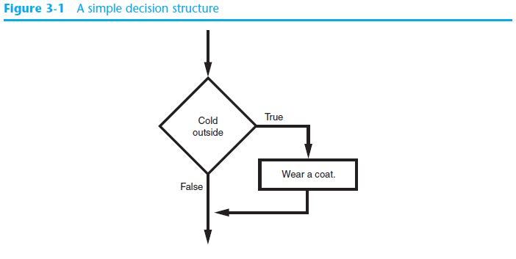
The if Statement (cont’d.)

Slide 6
The if Statement (cont’d.)
Python syntax:
if condition:
Statement
Statement
First line known as the if clause
Includes the keyword if followed by condition
The condition can be true or false
When the if statement executes, the condition is tested, and if it is true the block statements are executed. otherwise, block statements are skipped

Slide 7
Boolean Expressions and Relational Operators
Boolean expression: expression tested by if statement to determine if it is true or false
Example: a > b
true if a is greater than b; false otherwise
Relational operator: determines whether a specific relationship exists between two values
Example: greater than (>)

Slide 8
Boolean Expressions and Relational Operators (cont’d.)
>= and <= operators test more than one relationship
It is enough for one of the relationships to exist for the expression to be true
== operator determines whether the two operands are equal to one another
Do not confuse with assignment operator (=)
!= operator determines whether the two operands are not equal

Slide 9
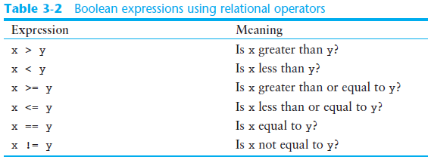
Boolean Expressions and Relational Operators (cont’d.)

Slide 10
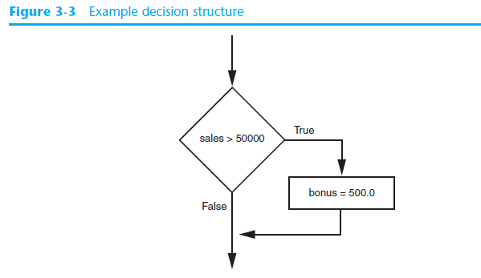
Boolean Expressions and Relational Operators (cont’d.)
Using a Boolean expression with the > relational operator

Slide 11
Boolean Expressions and Relational Operators (cont’d.)
Any relational operator can be used in a decision block
Example: if balance == 0
Example: if payment != balance
It is possible to have a block inside another block
Example: if statement inside a function
Statements in inner block must be indented with respect to the outer block

Slide 12
Single-Line if Statements
An if statement can be written on a single line if it executes only one statement.
Python syntax:
if condition: statement
Example:
if score > 59: print('You passed!')

Slide 13
The if-else Statement
Dual alternative decision structure: two possible paths of execution
One is taken if the condition is true, and the other if the condition is false
Syntax: if condition:
statements
else:
other statements
if clause and else clause must be aligned
Statements must be consistently indented

Slide 14
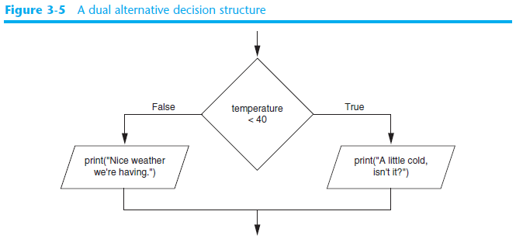
The if-else Statement (cont’d.)

Slide 15
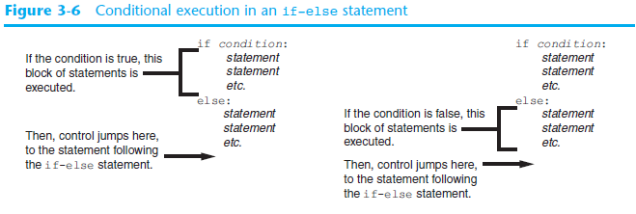
The if-else Statement (cont’d.)

Slide 16
Comparing Strings
Strings can be compared using the == and != operators
String comparisons are case sensitive
Strings can be compared using >, <, >=, and <=
Compared character by character based on the ASCII values for each character
If shorter word is substring of longer word, longer word is greater than shorter word

Slide 17
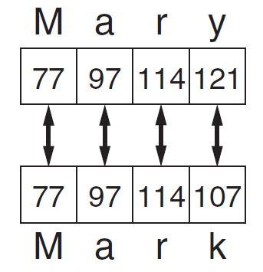
Comparing Strings (cont’d.)

Slide 18
Nested Decision Structures and the if-elif-else Statement
A decision structure can be nested inside another decision structure
Commonly needed in programs
Example:
Determine if someone qualifies for a loan, they must meet two conditions:
Must earn at least $30,000/year
Must have been employed for at least two years
Check first condition, and if it is true, check second condition

Slide 19
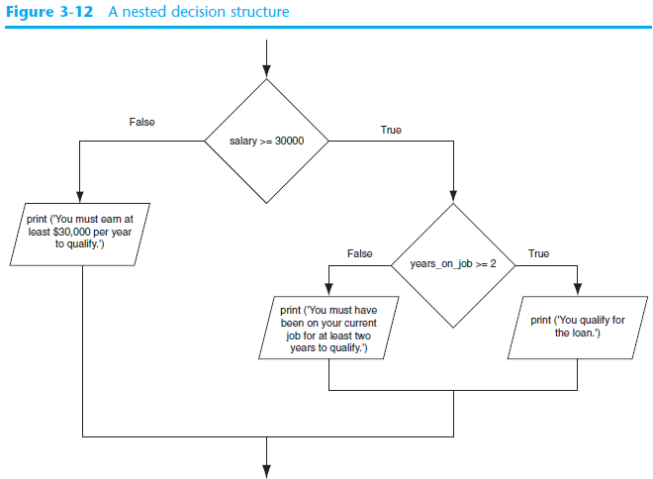

Slide 20
Nested Decision Structures and the if-elif-else Statement (cont’d.)
Important to use proper indentation in a nested decision structure
Important for Python interpreter
Makes code more readable for programmer
Rules for writing nested if statements:
else clause should align with matching if clause
Statements in each block must be consistently indented

Slide 21
The if-elif-else Statement
if-elif-else statement: special version of a decision structure
Makes logic of nested decision structures simpler to write
Can include multiple elif statements
Syntax:
if condition_1:
statement(s)
elif condition_2:
statement(s)
elif condition_3:
statement(s)
else
statement(s)
Insert as many elif clauses
as necessary.

Slide 22
The if-elif-else Statement (cont’d.)
Alignment used with if-elif-else statement:
if, elif, and else clauses are all aligned
Conditionally executed blocks are consistently indented
if-elif-else statement is never required, but logic easier to follow
Can be accomplished by nested if-else
Code can become complex, and indentation can cause problematic long lines

Slide 23
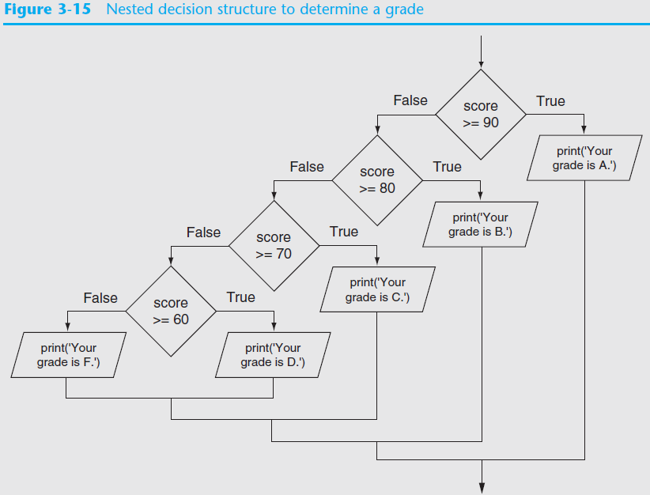

Slide 24
Logical Operators
Logical operators: operators that can be used to create complex Boolean expressions
and operator and or operator: binary operators, connect two Boolean expressions into a compound Boolean expression
not operator: unary operator, reverses the truth of its Boolean operand

Slide 25
The and Operator
Takes two Boolean expressions as operands
Creates compound Boolean expression that is true only when both sub expressions are true
Can be used to simplify nested decision structures
Truth table for
the and operator
Value of the Expression | Expression
false | false and false
false | false and true
false | true and false
true | true and true

Slide 26
The or Operator
Takes two Boolean expressions as operands
Creates compound Boolean expression that is true when either of the sub expressions is true
Can be used to simplify nested decision structures
Truth table for
the or operator
Value of the Expression | Expression
false | false and false
true | false and true
true | true and false
true | true and true

Slide 27
Short-Circuit Evaluation
Short circuit evaluation: deciding the value of a compound Boolean expression after evaluating only one sub expression
Performed by the or and and operators
For or operator: If left operand is true, compound expression is true. Otherwise, evaluate right operand
For and operator: If left operand is false, compound expression is false. Otherwise, evaluate right operand

Slide 28
The not Operator
Takes one Boolean expressions as operand and reverses its logical value
Sometimes it may be necessary to place parentheses around an expression to clarify to what you are applying the not operator
Truth table for the not operator
Value of the Expression | Expression
false | true
true | false

Slide 29
Checking Numeric Ranges with Logical Operators
To determine whether a numeric value is within a specific range of values, use and
Example: x >= 10 and x <= 20
To determine whether a numeric value is outside of a specific range of values, use or
Example: x < 10 or x > 20

Slide 30
Boolean Variables
Boolean variable: references one of two values, True or False
Represented by bool data type
Commonly used as flags
Flag: variable that signals when some condition exists in a program
Flag set to False → condition does not exist
Flag set to True → condition exists

Slide 31
Conditional Expressions
Syntax: value_1 if condition else value_2
condition is a Boolean expression that is tested
If condition is true, the expression gives us value_1
If condition is false, the expression gives us value_2

Slide 32
Conditional Expressions
Example: grade = 'Pass' if score > 59 else 'Fail'
If score is greater than 59, grade is assigned 'Pass'. Otherwise, grade is assigned 'Fail'.
Equivalent to:
if score > 59: grade = 'Pass'
else:
grade = 'Fail'

Slide 33
Conditional Expressions
Example: max = num1 if num1 > num2 else num2
If num1 is greater than num2, max is assigned num1. Otherwise, max is assigned num2.
Equivalent to:
if num1 > num2: max = num1
else:
max = num2

Slide 34
Assignment Expressions and the Walrus Operator
The walrus operator := is an enhanced assignment operator
You use the walrus operator to create assignment expressions
An assignment expression does two things:
It assigns a value to a variable
It returns the value that was assigned to the variable

Slide 35
Assignment Expressions and the Walrus Operator
Example: print(num := 99)
This statement does two things:
It assigns 99 to the num variable
It prints the value that was assigned to the num variable, 99

Slide 36
Assignment Expressions and the Walrus Operator
Example: if (pay := hours * pay_rate) > 40: print('You worked overtime')
This if statement does the following:
The pay variable is assigned the value of hours * pay_rate
If the value that was assigned to pay is greater than 40, the message You worked overtime is displayed.

Slide 37
Assignment Expressions and the Walrus Operator
Precedence of the walrus operator
The walrus operator has the lowest precedence of all the operators in Python
When using the walrus operator in a larger expression that also uses other operators, the walrus operator will work last
In most cases, you need to put parentheses around the assignment expression to make sure the walrus operator assigns the correct value to its variable

Slide 38
Assignment Expressions and the Walrus Operator
An assignment expression is not a complete statement
For example, this alone causes an error: num := 99
It must be written as part of a larger statement print(num := 99)

Slide 39
Turtle Graphics: Determining the State of the Turtle
The turtle.xcor() and turtle.ycor() functions return the turtle's X and Y coordinates
Examples of calling these functions in an if statement:
if turtle.ycor() < 0:
turtle.goto(0, 0)
if turtle.xcor() > 100 and turtle.xcor() < 200:
turtle.goto(0, 0)

Slide 40
Turtle Graphics: Determining the State of the Turtle
The turtle.heading() function returns the turtle's heading. (By default, the heading is returned in degrees.)
Example of calling the function in an if statement:
if turtle.heading() >= 90 and turtle.heading() <= 270:
turtle.setheading(180)

Slide 41
Turtle Graphics: Determining the State of the Turtle
The turtle.isdown() function returns True if the pen is down, or False otherwise.
Example of calling the function in an if statement:
if turtle.isdown():
turtle.penup()
if not(turtle.isdown()):
turtle.pendown()

Slide 42
Turtle Graphics: Determining the State of the Turtle
The turtle.isvisible() function returns True if the turtle is visible, or False otherwise.
Example of calling the function in an if statement:
if turtle.isvisible():
turtle.hideturtle()

Slide 43
Turtle Graphics: Determining the State of the Turtle
When you call turtle.pencolor() without passing an argument, the function returns the pen's current color as a string. Example of calling the function in an if statement:
When you call turtle.fillcolor() without passing an argument, the function returns the current fill color as a string. Example of calling the function in an if statement:
if turtle.pencolor() == 'red':
turtle.pencolor('blue')
if turtle.fillcolor() == 'blue':
turtle.fillcolor('white')

Slide 44
Turtle Graphics: Determining the State of the Turtle
When you call turtle.bgcolor() without passing an argument, the function returns the current background color as a string. Example of calling the function in an if statement:
if turtle.bgcolor() == 'white':
turtle.bgcolor('gray')

Slide 45
Turtle Graphics: Determining the State of the Turtle
When you call turtle.pensize() without passing an argument, the function returns the pen's current size as a string. Example of calling the function in an if statement:
if turtle.pensize() < 3:
turtle.pensize(3)

Slide 46
Turtle Graphics: Determining the State of the Turtle
When you call turtle.speed() without passing an argument, the function returns the current animation speed. Example of calling the function in an if statement:
if turtle.speed() > 0:
turtle.speed(0)

Slide 47
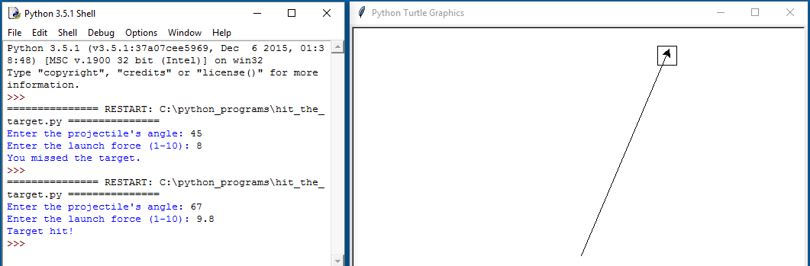
Turtle Graphics: Determining the State of the Turtle
See In the Spotlight: The Hit the Target Game in your textbook for numerous examples of determining the state of the turtle.

Slide 48
Summary
This chapter covered:
Decision structures, including:
Single alternative decision structures
Dual alternative decision structures
Nested decision structures
Relational operators and logical operators as used in creating Boolean expressions
String comparison as used in creating Boolean expressions
Boolean variables
Determining the state of the turtle in Turtle Graphics

